Slide 1

INSTITUTE: UIE (AIT-CSE)
Computer Networks CST- 348
Lecture – 1.6 and 1.7
OSI and TCP/IP Model
By : Dr. Monica Luthra(e9836)
DISCOVER . LEARN . EMPOWER

Slide 2

Course Objectives
CO Number | Title
CO1 | Describe the important networking concepts
CO2 | Understand concept of network reference models and protocols
CO3 | Apply the concepts of routing algorithms on various networks
CO4 | Identify mechanism to handle traffic and control on congestion
CO5 | Identify and understand connection establishment techniques and features

Slide 3

Course Outcomes
After this course student will be able to:
To bring together several key of Computer network design and architecture
To Familiarize the student with the basic taxonomy and terminology of the computer networking area.
To Allow the student to gain expertise in some specific areas of networking such as the design and maintenance of individual networks.

Slide 4

OSI Model
This model was proposed to make standardization of protocols defined for various Layers. Hence it is widely represented as ISO OSI Reference Model.
It allows open communication between different systems without requiring changes to the logic of underlying h/w and s/w.
It is just a model not a protocol that can be run/install on a machine. It has 7 abstracted layers
Every layer is designed to give abstracted level of functionality and is independent from other layer
Each layers should perform a set of desired functions
Defined functions should be according to the policies of Internationally Standardized Protocols.

Slide 5
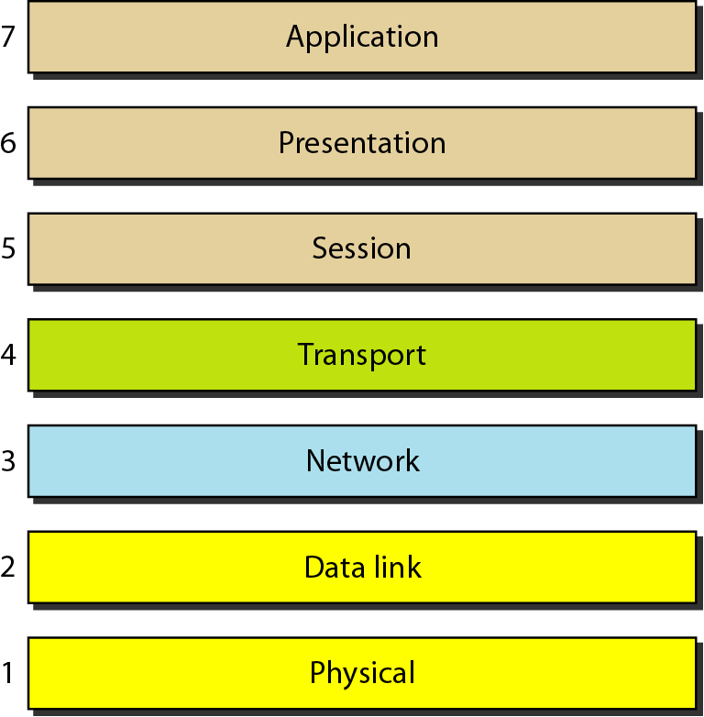
Seven layers of the OSI model
Please Do Not Throw Sausage Pizza Away
All People Seem To Need Data Processing
Image Source : https://www.geeksforgeeks.org/layers-of-osi-model/

Slide 6
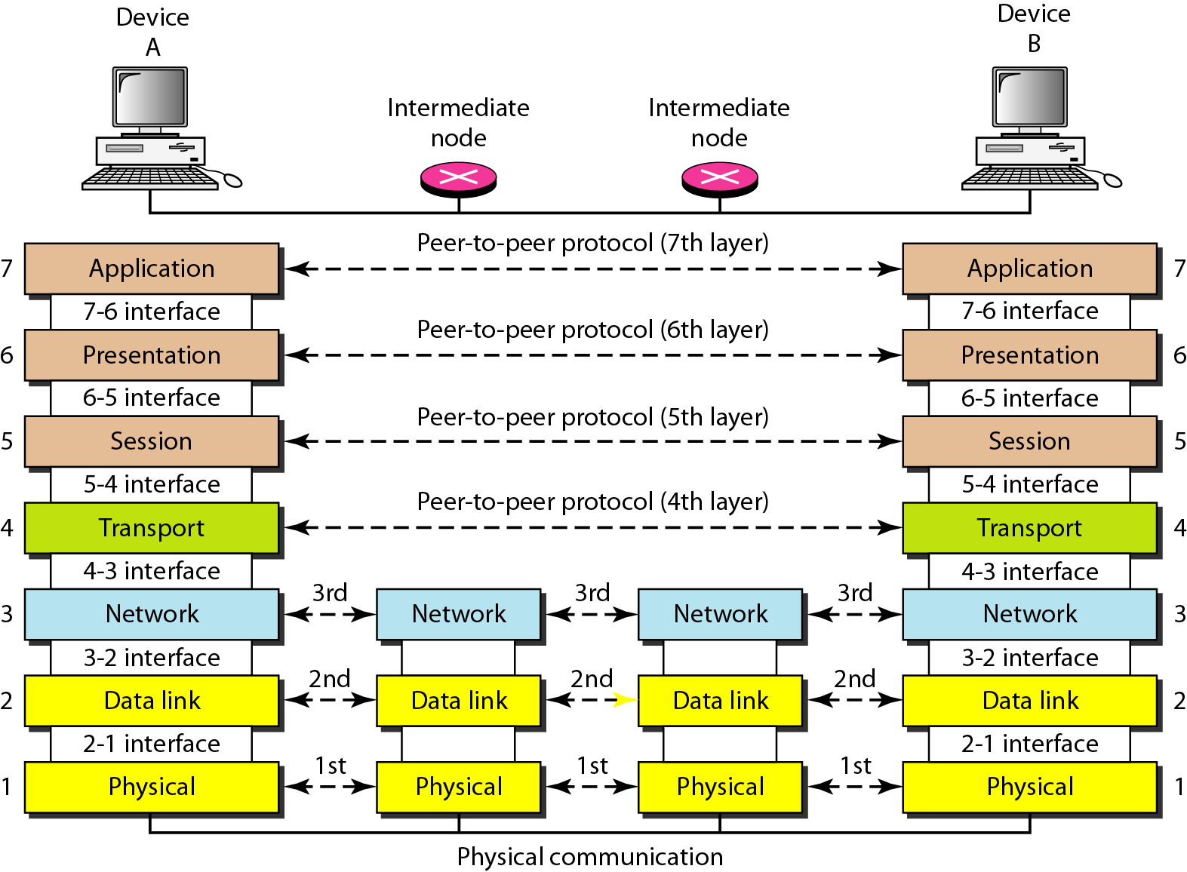
The Interaction between layers in the OSI model
Image Source : https://www.geeksforgeeks.org/layers-of-osi-model/

Slide 7
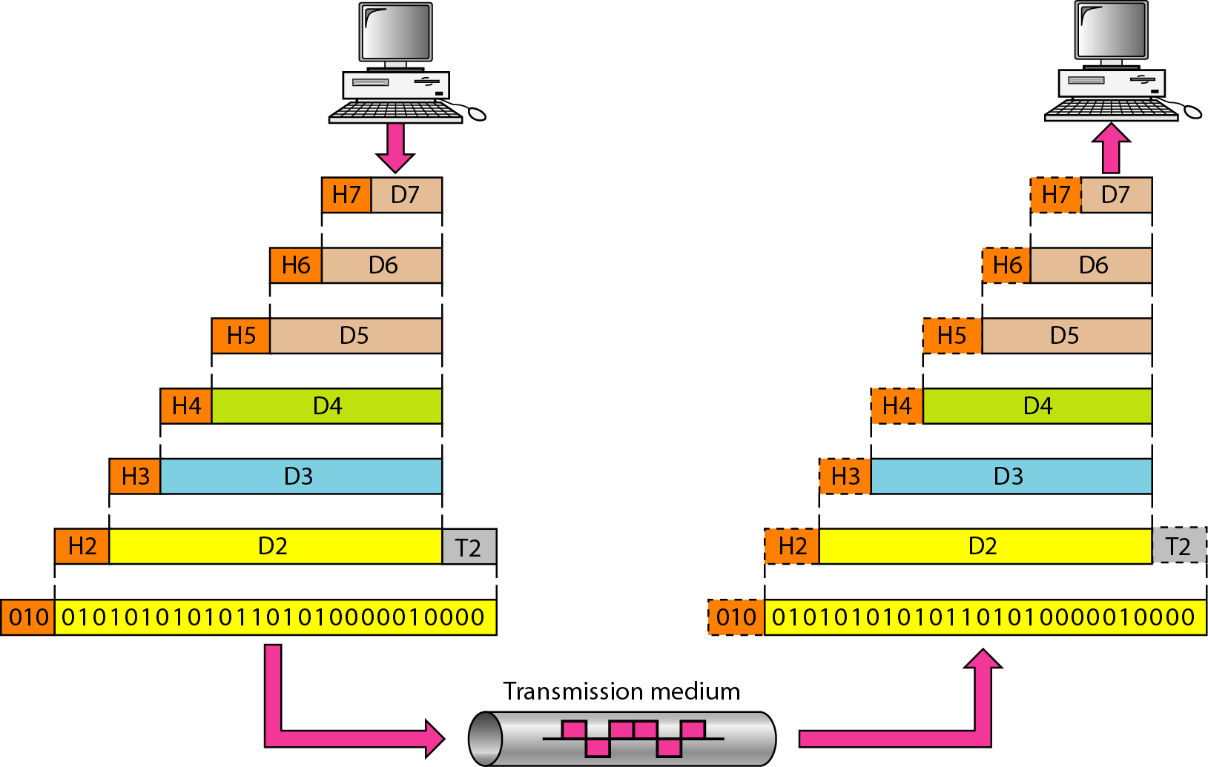
An exchange using the OSI model
As data is passed between layers each layer in sending machine adds its own information (headers and trailers)into message it receive from layer just above it and passes whole package to layer just below it.
Image Source : https://www.geeksforgeeks.org/layers-of-osi-model/

Slide 8
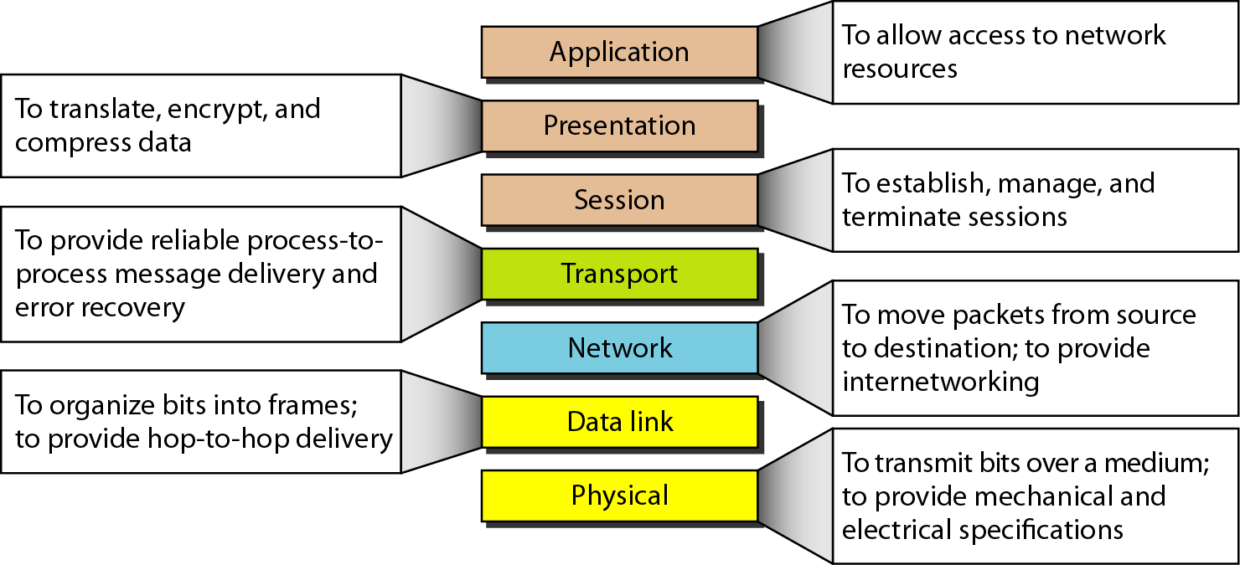
Summary of layers
Image Source : https://www.geeksforgeeks.org/layers-of-osi-model/

Slide 9
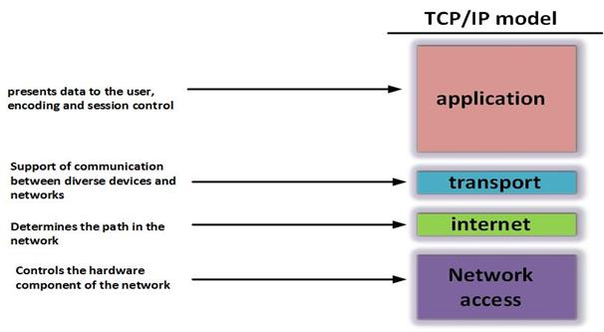
TCP/IP Model
Image Source : https://www.geeksforgeeks.org/layers-of-osi-model/

Slide 10
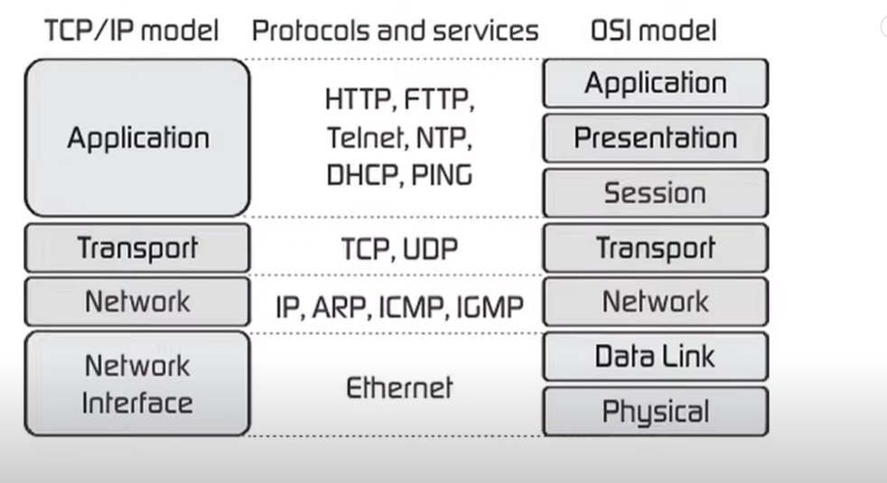

Slide 11
Network Access and Physical Layers
TCP/IP reference model does not discuss these layers too much
the node should connect to the network with a protocol such that it can send IP packets
mostly in hardware
Also known as Network interface layer.

Slide 12
Internet Layer
Connectionless, point to point internetworking protocol (uses the datagram approach)
takes care of routing across multiple networks
each packet travels in the network independently of each other
they may not arrive (if there is a problem in the network)
they may arrive out of order
Implemented in end systems and routers as the Internet Protocol (IP)

Slide 13
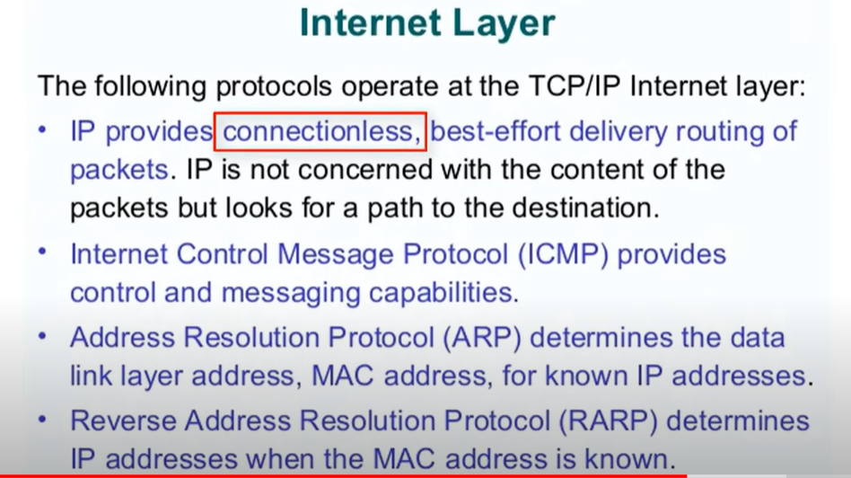

Slide 14
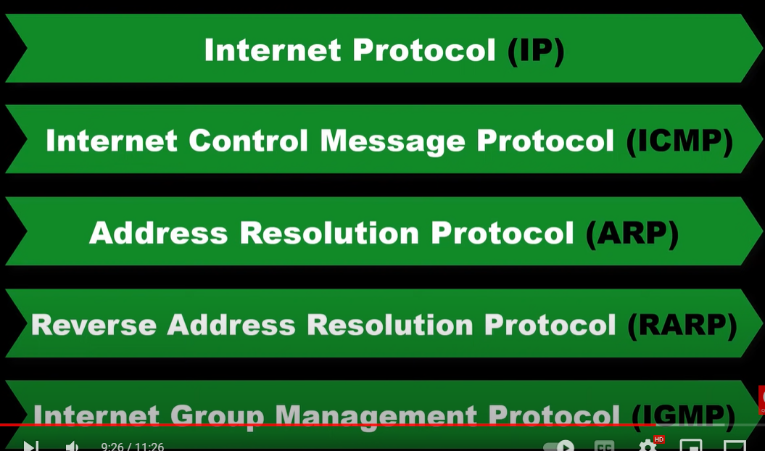
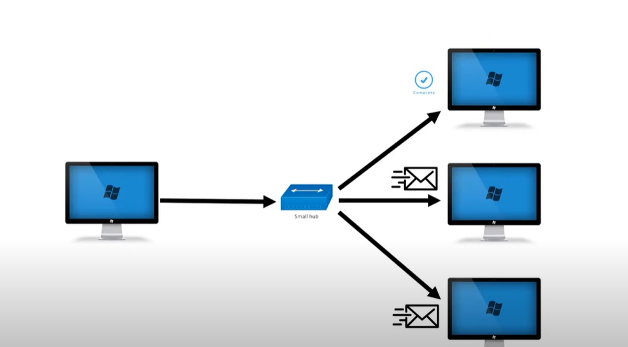

Slide 15
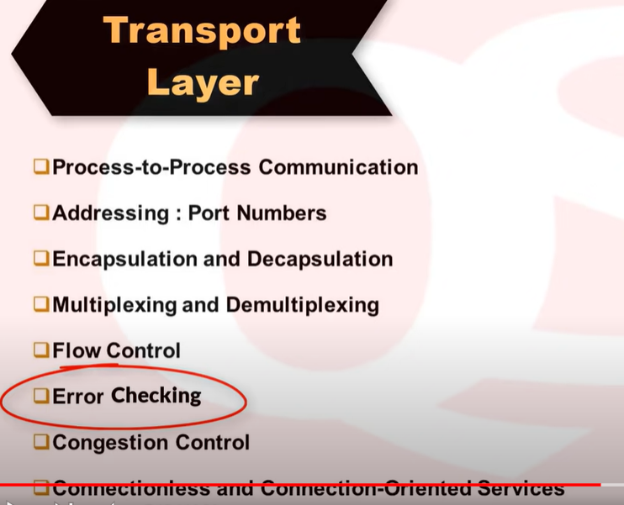
Transport Layer
End-to-end data transfer
Transmission Control Protocol (TCP)
connection oriented
reliable delivery of data
ordering of delivery
User Datagram Protocol (UDP)
connectionless service
delivery is not guaranteed

Slide 16
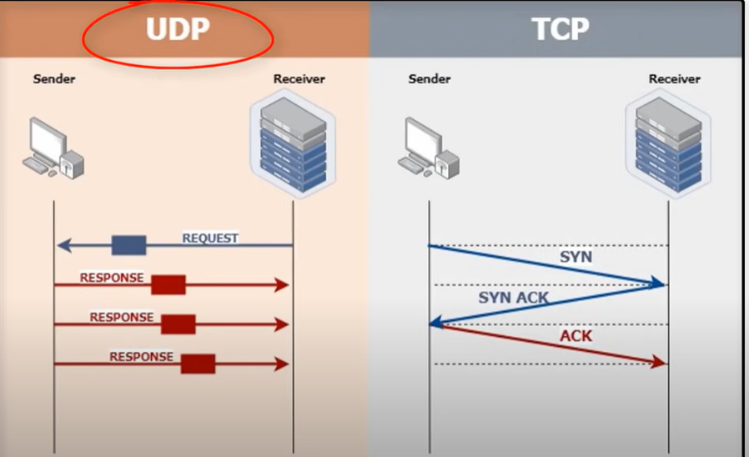

Slide 17
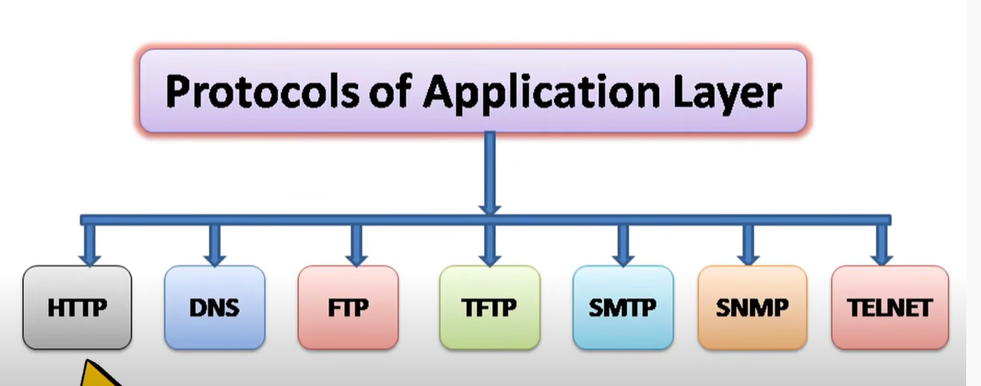
Application Layer
Support for user applications
A separate module for each different application
e.g. HTTP, SMTP, telnet

Slide 18
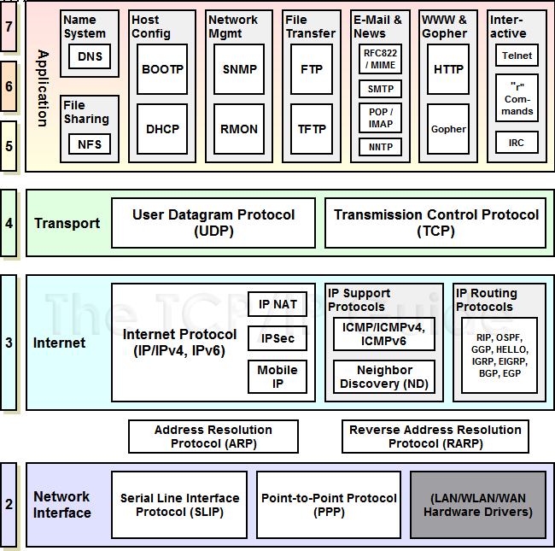
TCP/IP Protocol Suite
Image Source : https://www.geeksforgeeks.org/layers-of-osi-model/

Slide 19
Key Points
Data communications are the transfer of data from one device to another via some form of transmission medium.
A data communications system must transmit data to the correct destination in an
accurate and timely manner.
Text, numbers, images, audio, and video are different forms of information.
Data flow between two devices can occur in one of three ways: simplex, half-duplex, or full-duplex.
In a point-to-point connection, two and only two devices are connected by a
dedicated link. In a multipoint connection, three or more devices share a link.
Topology refers to the physical or logical arrangement of a network. Devices may be arranged in a mesh, star, bus, or ring topology.
A network can be categorized as a local area network or a wide area network.
There are local, regional, national, and international Internet service providers.
A protocol is a set of rules that govern data communication; the key elements of a protocol are syntax, semantics, and timing

Slide 20
References
https://www.geeksforgeeks.org/basics-computer-networking/
https://www.youtube.com/watch?v=VwN91x5i25g&list=PLBlnK6fEyqRgMCUAG0XRw78UA8qnv6jEx
http://www.svecw.edu.in/Docs%5CCSECNLNotes2013.pdf
https://www.cloudflare.com/learning/ddos/glossary/open-systems-interconnection-model-osi/

Slide 21
THANK YOU
For queries
Email: monica.e9836@cumail.in

